Slide 1

Text Editor
-presented by
Group 16
46. Omkar Vitthal Savant
47. Diksha Pravin Sawant
48. Om Vilas Shimpi

Slide 2
Introduction
Java
Text Editor

Slide 3

Java
Java is a high-level, class-based, object-oriented programming language that is designed to have as few implementation dependencies as possible.
It was designed by James Gosling in 1996.
It is handled by Oracle now.

Slide 4

Text Editor
A text editor is a type of computer program that edits plain text.
Such programs are sometimes known as "notepad" software
The name “Notepad” is from following the naming of Microsoft Notepad.

Slide 5
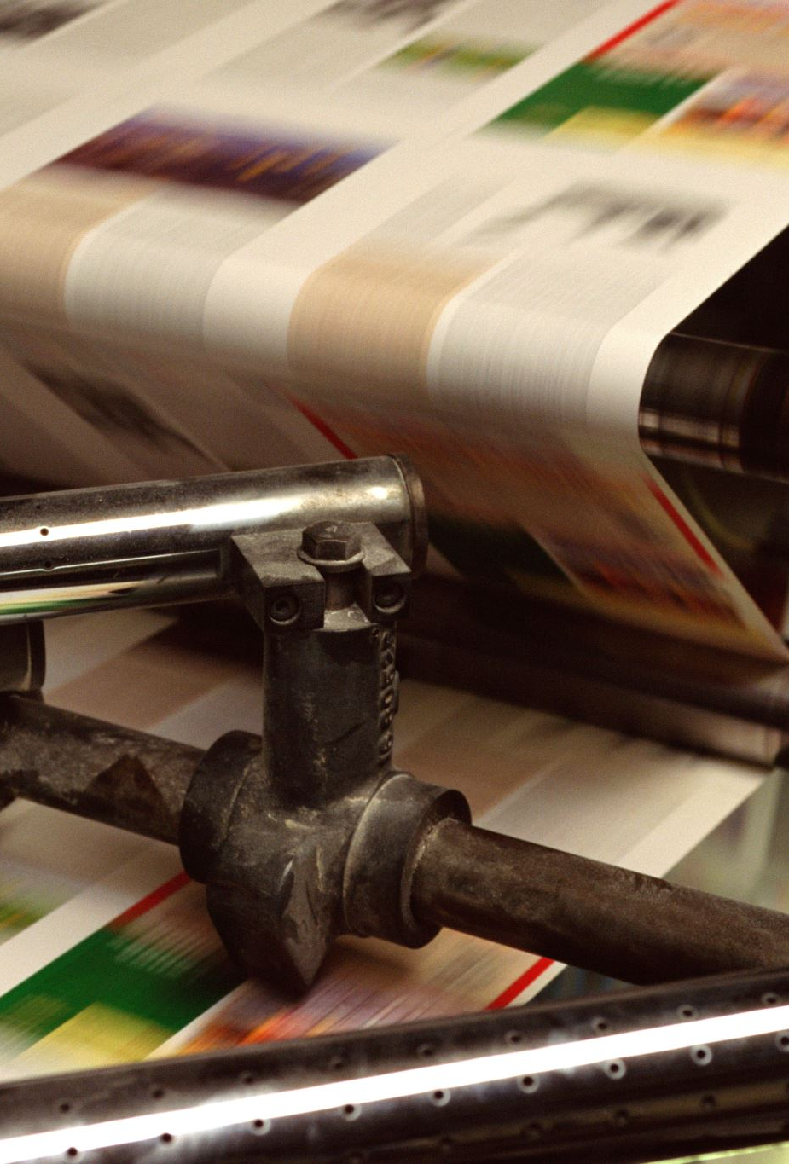
History
Java
Text Editor

Slide 6


Java
James Gosling, Mike Sheridan, and Patrick Naughton initiated the Java language project in June 1991.
Java was originally designed for interactive television, but it was too advanced for the digital cable television industry at the time.
Sun Microsystems released the first public implementation as Java 1.0 in 1996.

Slide 7

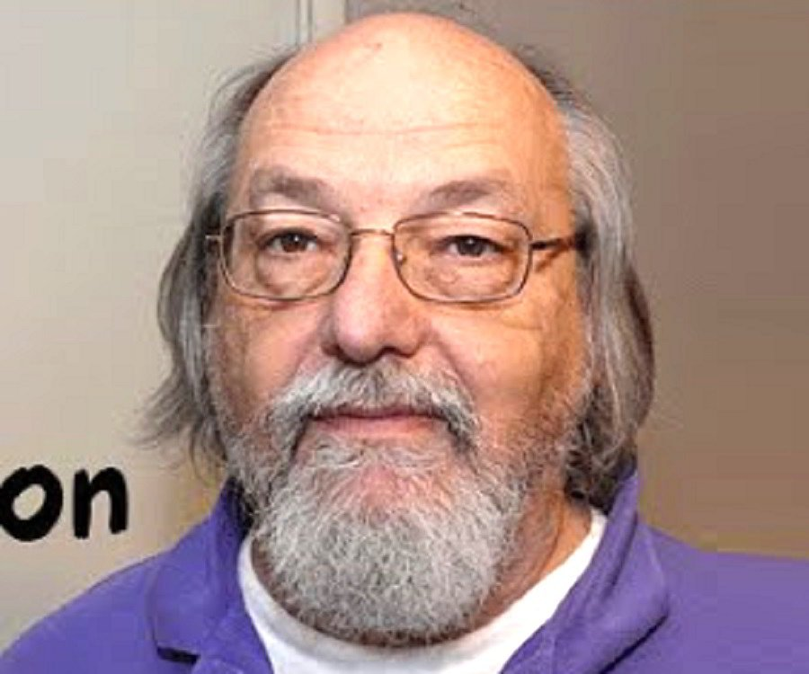
Text Editor
The first text editor called “ed” was created by Ken Thompson in August 1969 on a PDP-7 at AT&T Bell Labs.
The ed text editor was one of the first three key elements of the Unix operating system—assembler, editor, and shell.

Slide 8
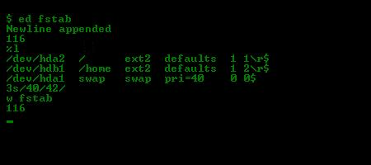

Slide 9
Software Requirements
Operating system : windows xp/7/8
Compiler used : java
IDE USED : Neatbeans
Front End : java, etc

Slide 10
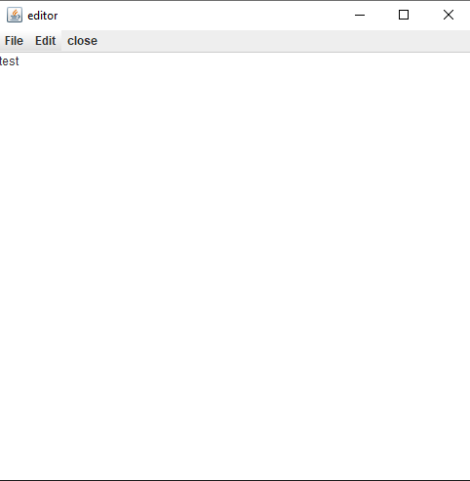
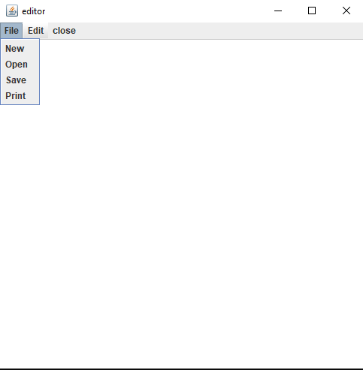
Output

Slide 11
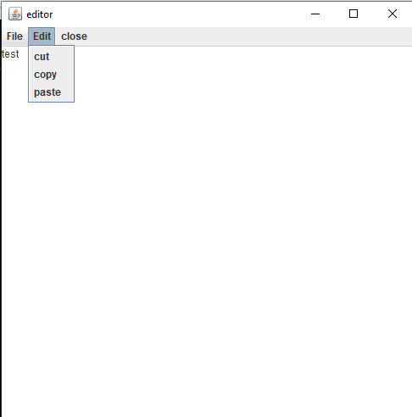
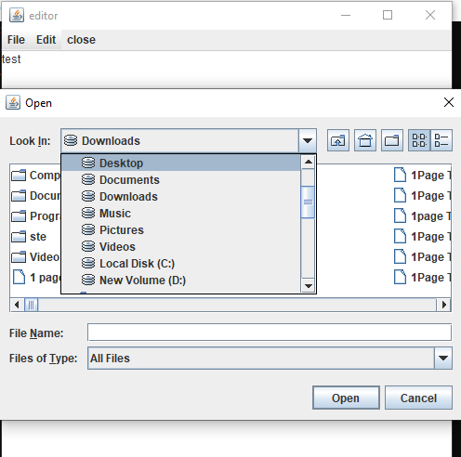
Output

Slide 12
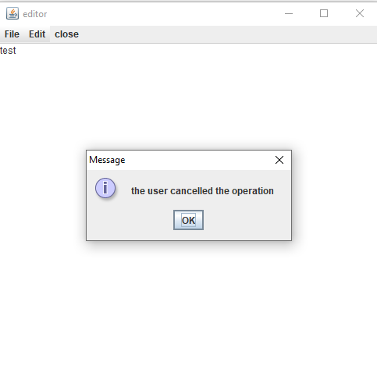
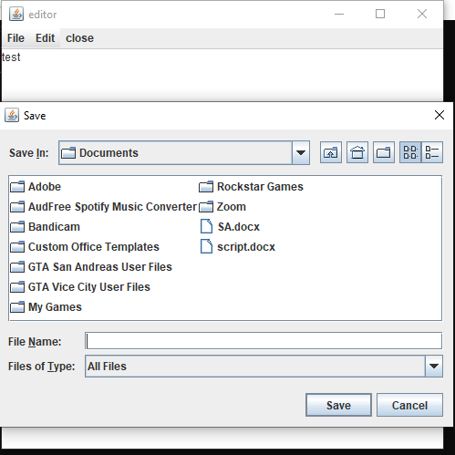
Output

Slide 13
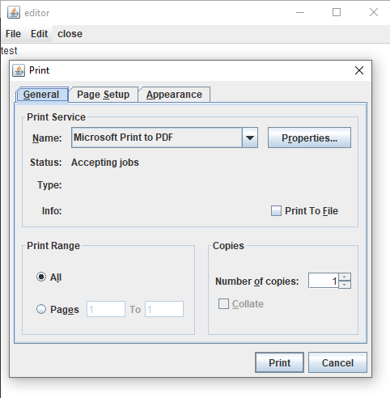
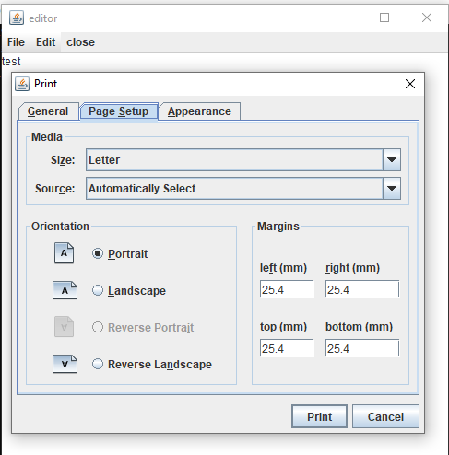
Output

Slide 14
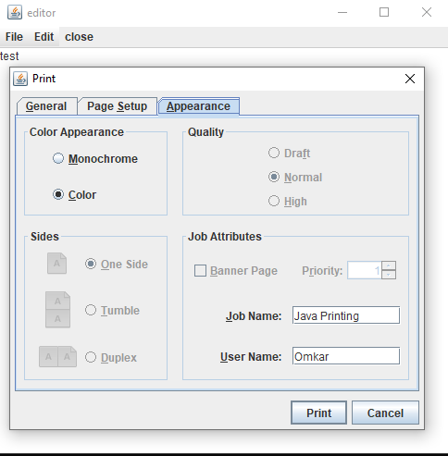
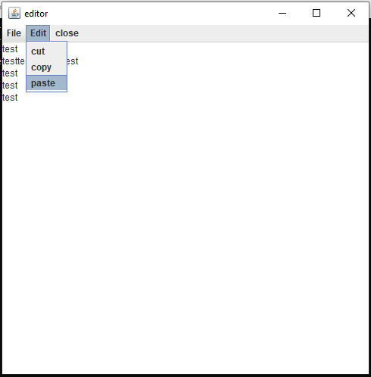
Output

Slide 15

Conclusion
Text Editor as a project helped us to understand different concepts of Advance Java Programming.
By implementing various packages and interfaces we understood the working of the program and the flow of the code efficiently.

Slide 16
Thank You!

